Slide 1
Import FF INTO HANA.
Milind Parab

Slide 2
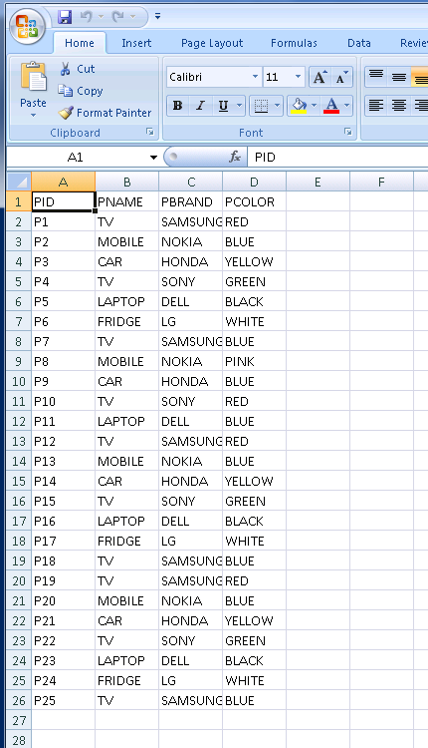
Data in FF.

Slide 3
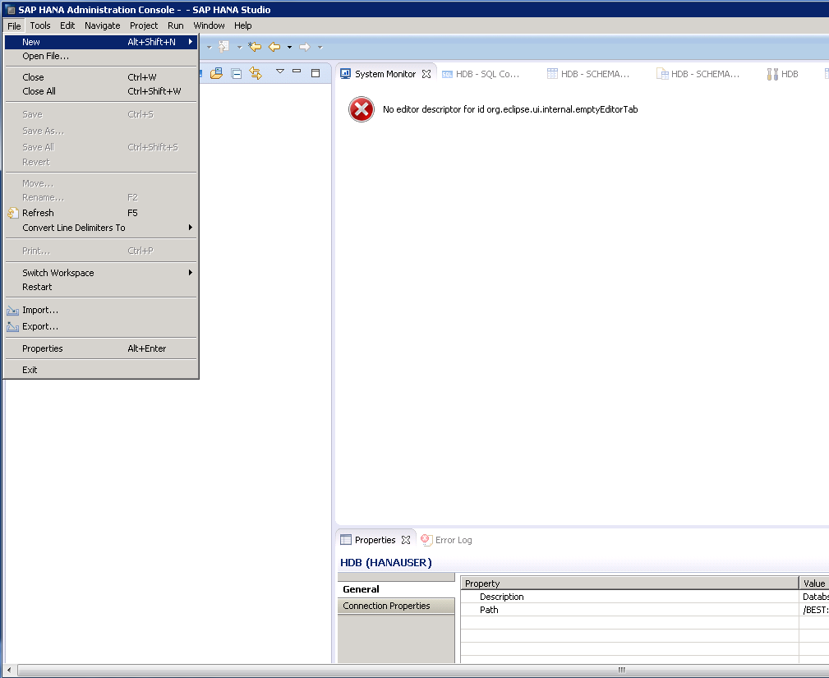
Go to File and Import.

Slide 4
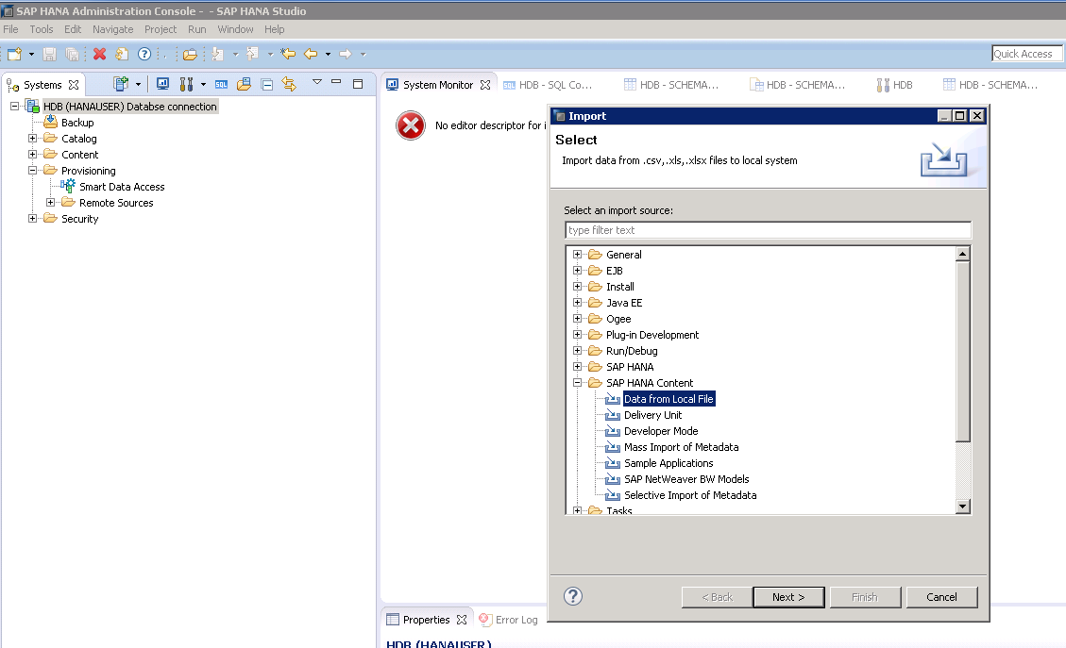
Go to SAP HANA content, Data from Local File.

Slide 5
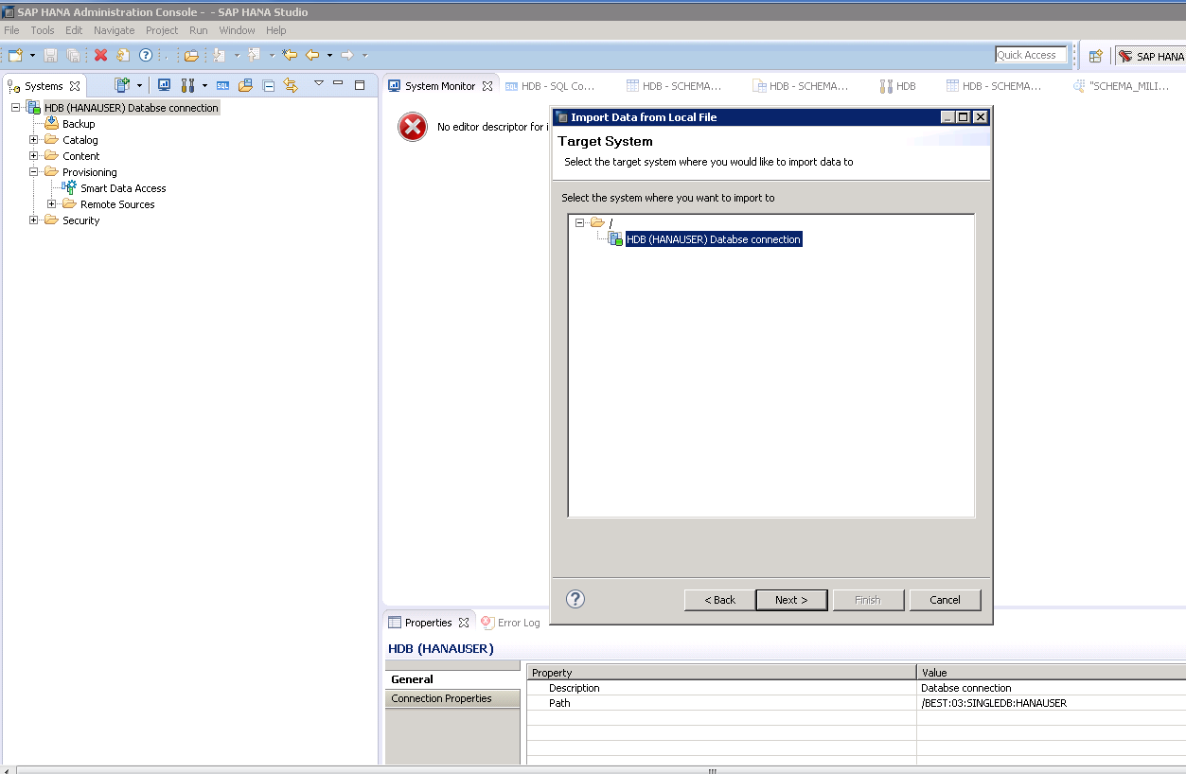
Select Database Server.

Slide 6
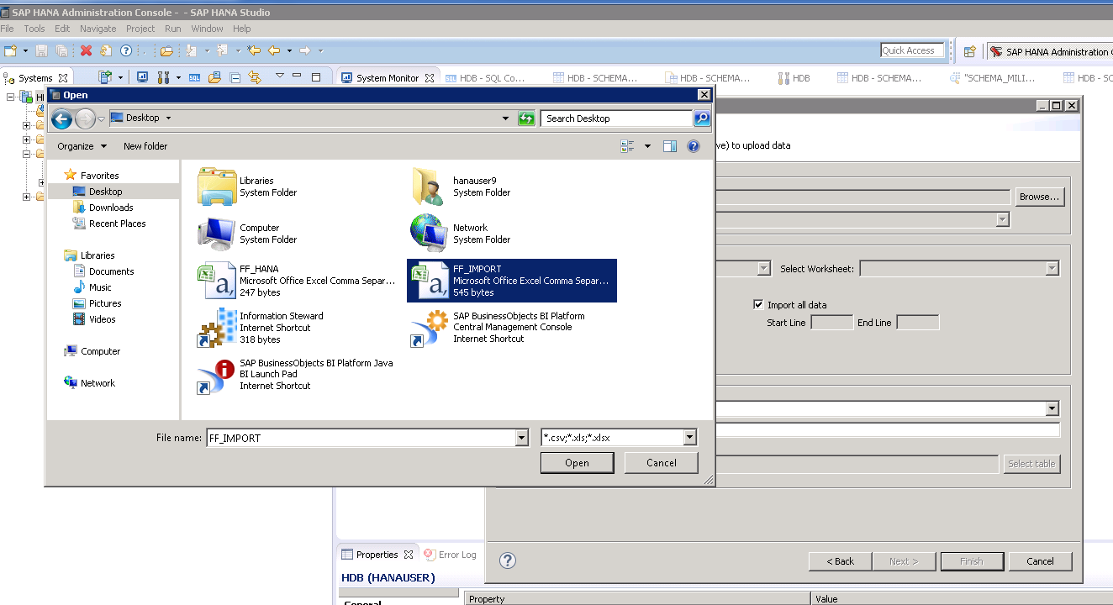
Browse and select the file.

Slide 7
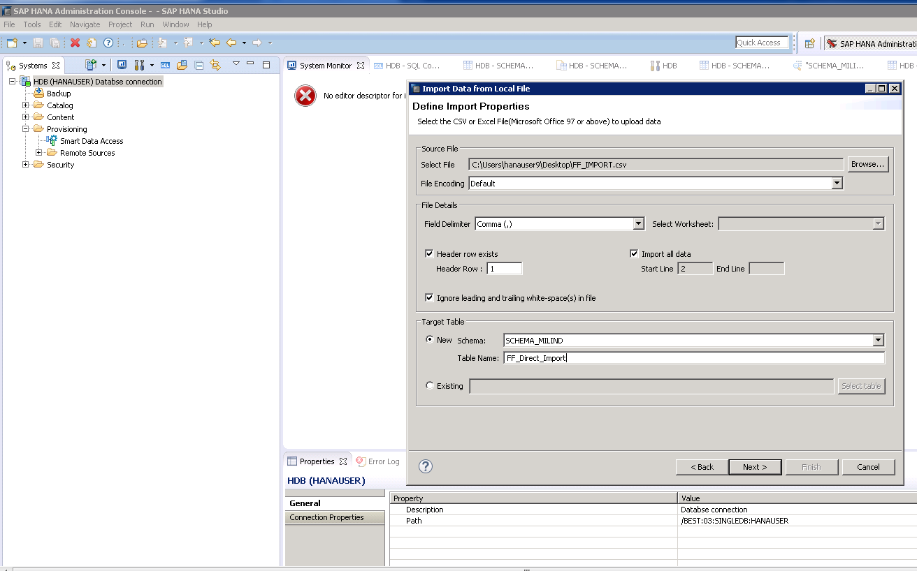
Update the information.

Slide 8
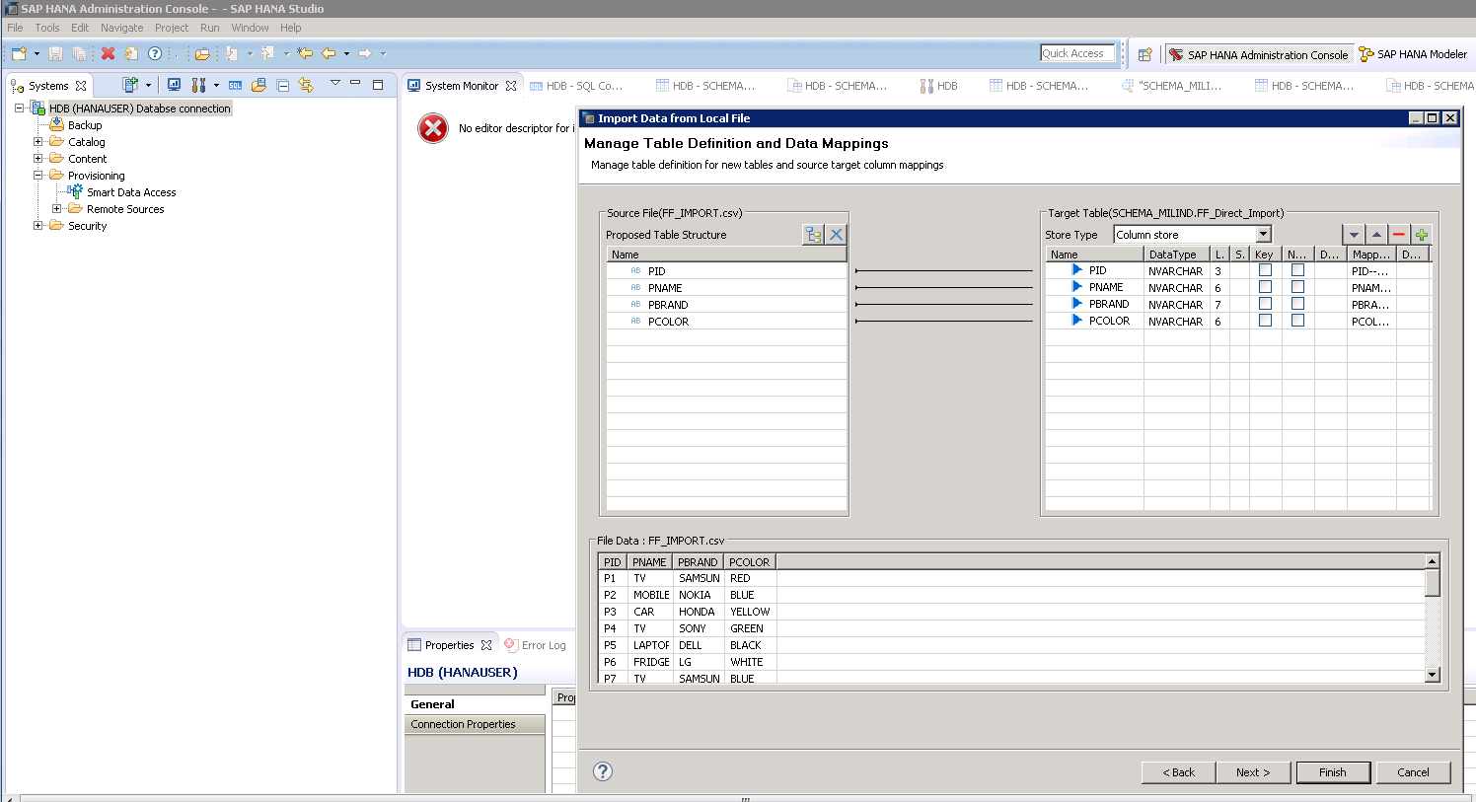
Cont.

Slide 9
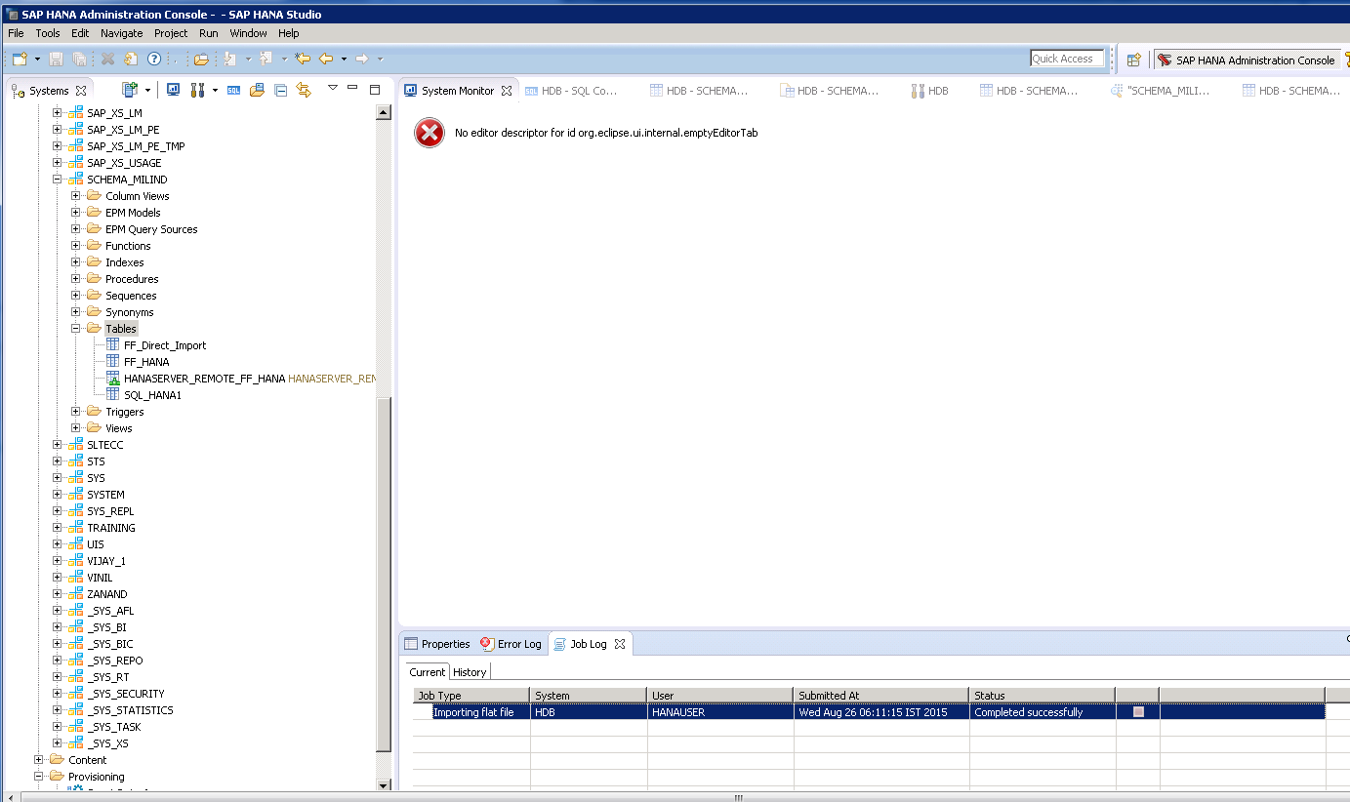
Table imported successfully.

Slide 10
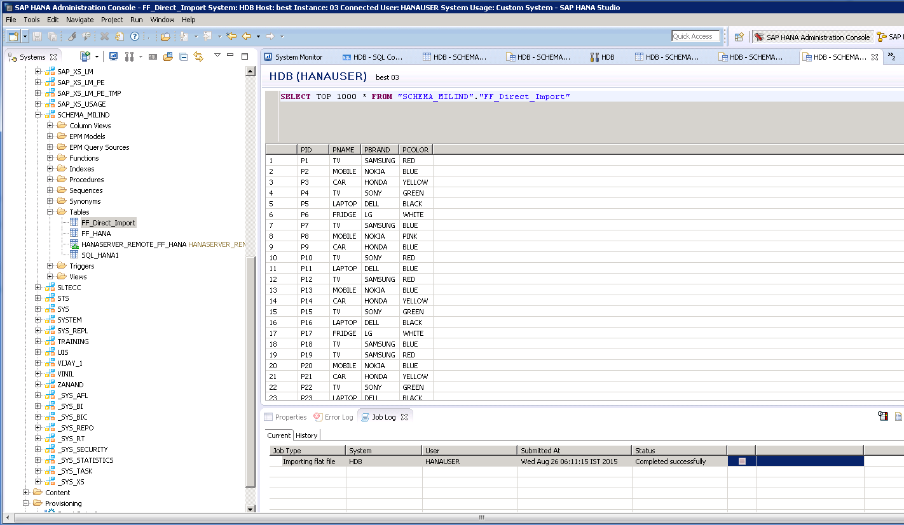
You can also see the data in imported table.

